Slide 1
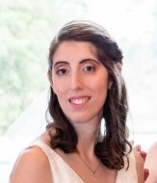
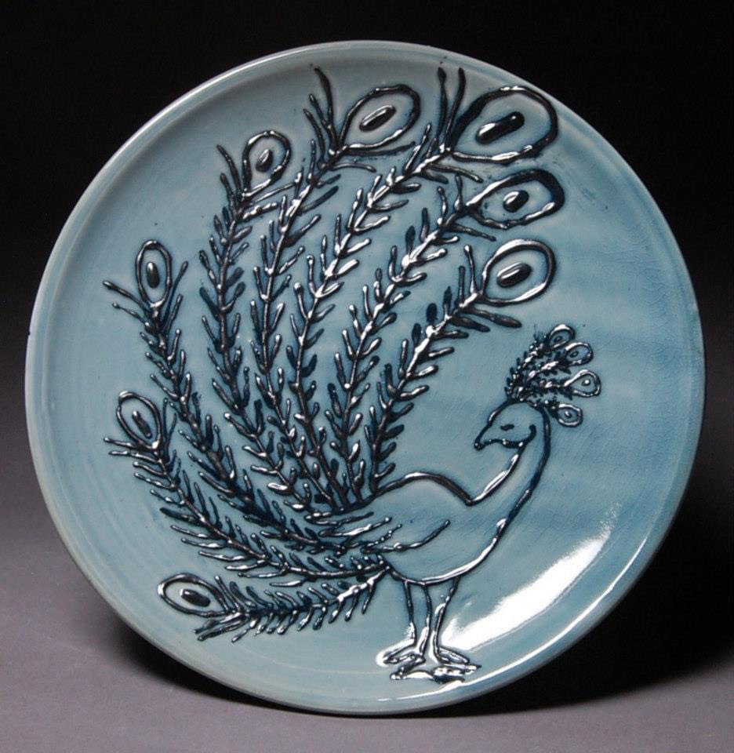
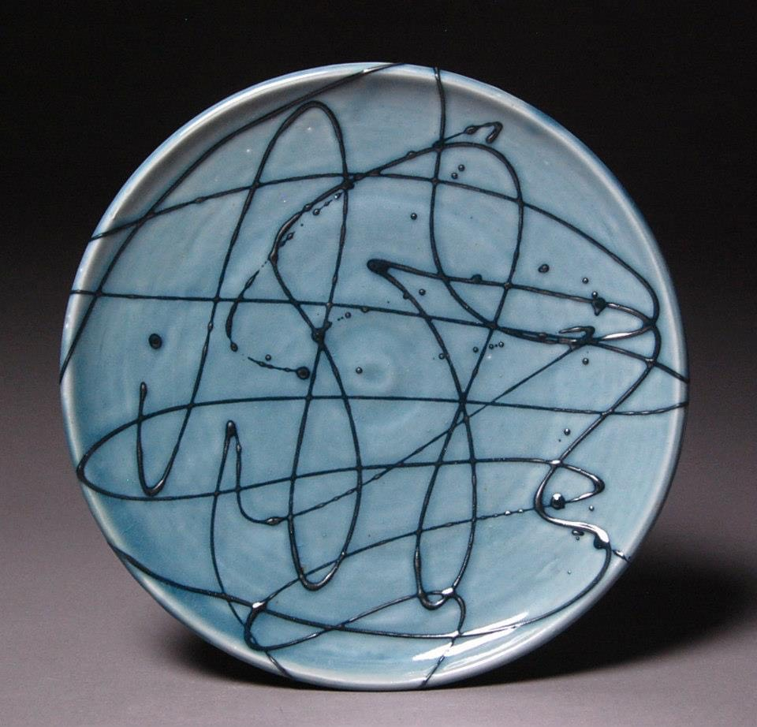
Mrs. Anne Lloyd Visual Arts Teacher

Slide 2
My Contact Information
Email: saffran@richmond.k12.ga.us
Remind: Text the following, appropriate code to: 81010
6th Grade - @tuttart6
7th Grade - @tuttart7
8th Grade - @tuttart8
Website link: https://www.rcboe.org/Page/55354
School Number: 706-737-7288

Slide 3
Daily Schedule
Planning: 9:20-9:50am
7th Grade: 9:55-11:25am
Lunch/Planning: 11:30 -12:10pm
6th Grade: 12:15-1:45pm
Planning: 1:50-2:30pm
8th Grade: 2:35- 4:05pm

Slide 4
CHECKOUT MY WEBSITE TO VIEW THE FOLLOWING INFORMATION
Week At A Glance (WAG)
Class Syllabus/Supply List
Resources
Additional Information

Slide 5
Arrival & Dismissal
Morning Arrival
Drop off your child on Dragon's Way behind the school.
Morning drop off for car riders is 8:50am.
Early drop off students are unsupervised. Please stay with your child until 8:50am when morning duty teach arrives.
Afternoon Dismissal
Bus riders will report to the bus loading zone.
Walkers will dismiss from the bus loading zone where the crossing guard is located.
Car rider pick up is 4:05pm.

Slide 6
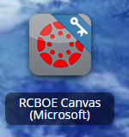
RCSS Learning Platform and Canvas
New to the Richmond County
Go to rcboe.org
Click Student
Click Launch Pad
Watch logging into Canvas as a student.
https://rcboe.instructuremedia.com/embed/048204ea-777e-4c04-9fc0-357111372c96
Your child will login through Launch Pad to access RCBOE Canvas.
Click link to watch Tutorial Video
https://www.rcboe.org/Domain/16265

Slide 7
THANK YOU FOR VISITING JOHN M. TUTT MIDDLE SCHOOL

